Slide 1
/sh/ sound
shop | short | shelf | ship | shake | short
fish | brush | trash | cash | wash | push
/ch/ sound
chip | chop | chat | chin | chew | church
much | porch | clutch | each | rich | witch

Slide 2
Soft /th/
throw | thick | thin | thank | thumb | thorn
path | mouth | throw | earth | bath | teeth
Hard /th/
that | them | this | there | that
father | mother | other | feather | weather

Slide 3
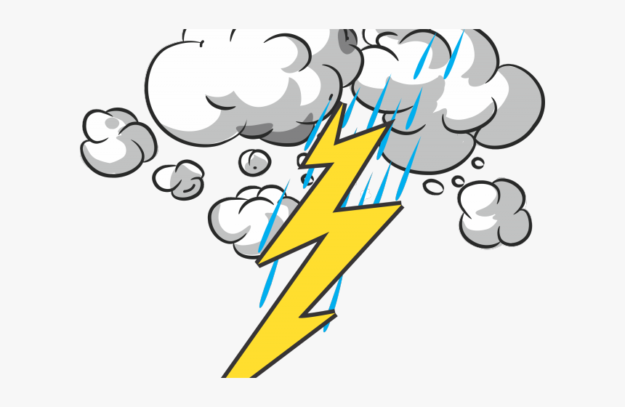
Theodore gets Thumped
Theodore heard the threatening thunder.
He thought it sounded thrilling.
Until three, thorny, lightning bolts,
Ended his thinking that Thursday.

